Slide 1
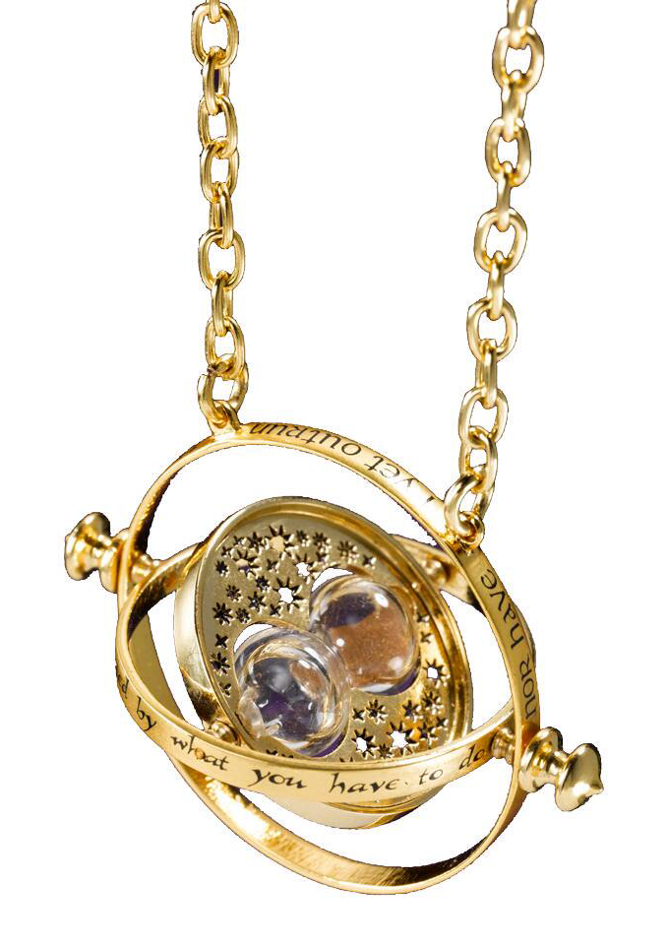
Time Turner
Hacking RF Attendance Systems (To Be in Two Places at Once)
Notes:
Hi! I'm going to be talking to you today about hacking RFID attendance systems to be in two places at once.

Slide 2

Notes:
Our story begins in the Spring of 2020 with an unnamed 18 year old Computer Science undergraduate student.

Slide 3
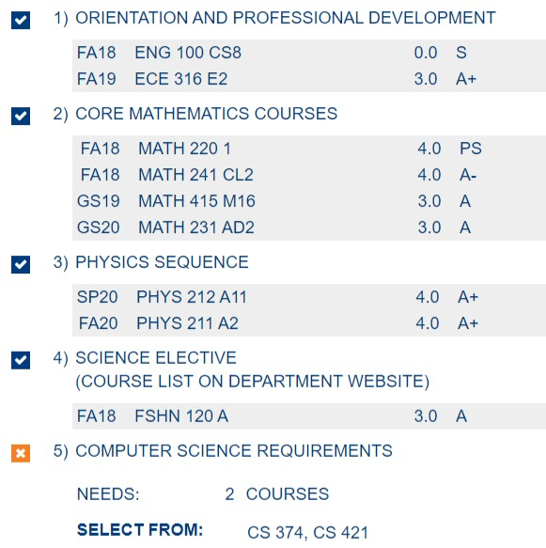
Notes:
With just 2 requirements left, he's about to become the youngest ever computer science graduate from his university. Unfortunately, as he's registering for his final semester of classes,

Slide 4
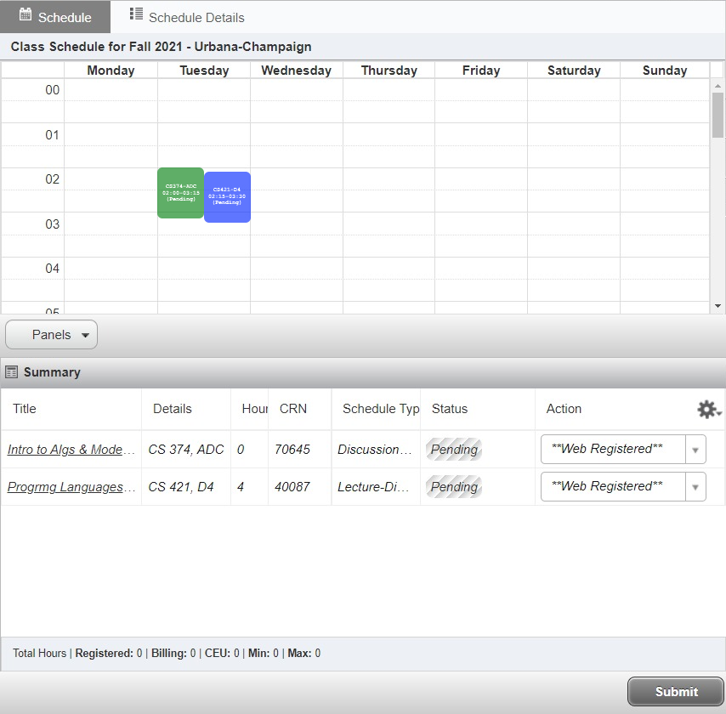
Notes:
he realizes that his two remaining courses are both scheduled at basically the same time. But surprisingly,

Slide 5
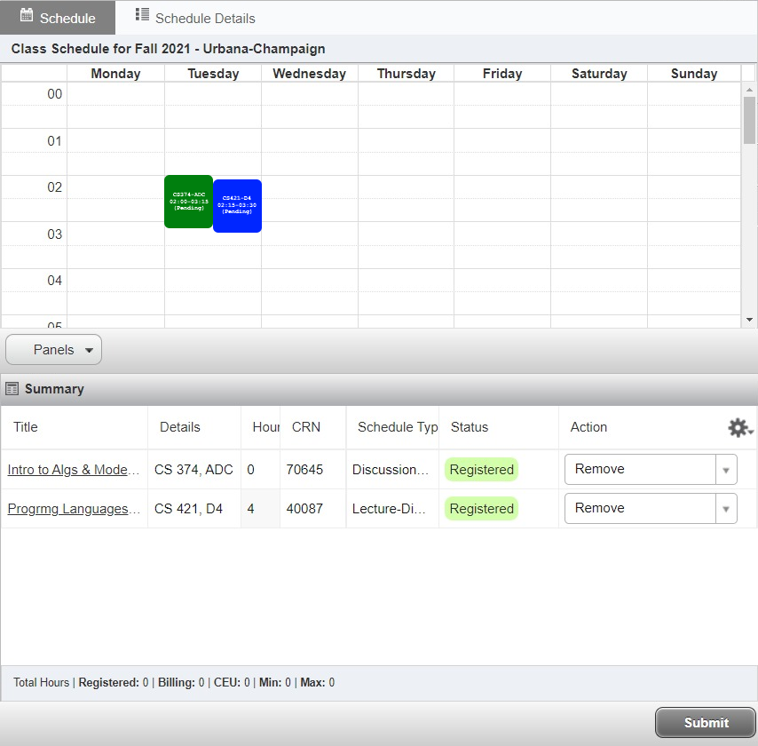
Notes:
he was able to register just fine - at the time, the scheduling system only checked whether classes were at the EXACT same start time - not whether they overlapped. So he registered for both classes and thought problem solved - I'm in.

Slide 6
Notes:
This student may or may not have been attending his classes regularly anyways, so how one can actually be present in two simultaneous classes was not at top of mind.

Slide 7
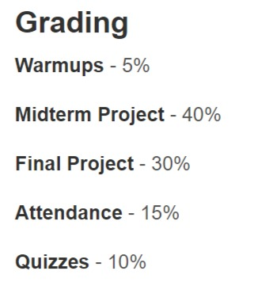
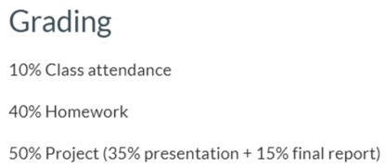
Notes:
And a quick look at the course syllabi revealed that between 10% and 15% of the points were for attendance. That means that missing half or even all of the lectures shouldn't be the end of the world. It wasn't until the week before classes started that he decided to look more closely,

Slide 8
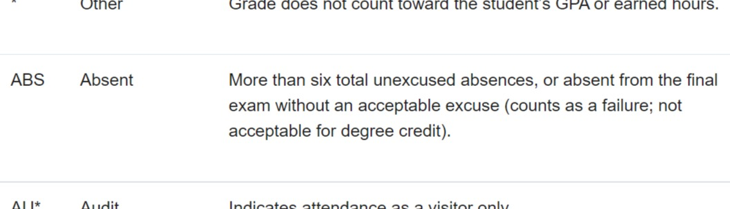
Notes:
and he was surprised to find a new policy that students with more than 6 unexcused absences would not be allowed to pass the course, they would have to retake it.

Slide 9
Notes:
Well this was an issue because he was so close to graduating, and he had a record to set after all. And so he started thinking about how these courses actually enforce the attendance policy. What do these large universities use to keep track of attendance for thousands of students?

Slide 10
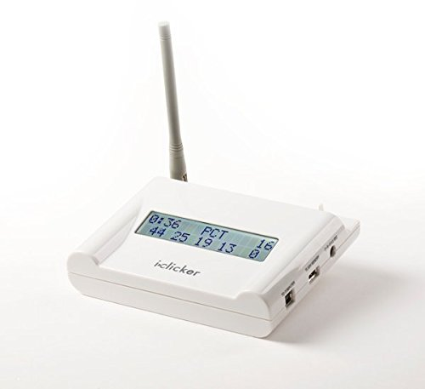
DEMO 1
Notes:
It turns out that THIS is what they use
It's an RFID-based polling system that has become increasingly popular at universities due to the ease of collecting attendance even for large lectures with hundreds of students.
Each student in the course is given a remote with a unique serial number that is linked to their student ID.
Throughout the lecture, instructors ask multiple-choice questions and have students select their answer from A-E by pressing the corresponding button on their remote. (click several buttons) Their answer and ID is then broadcast to the base station,
and instructors can later generate a list of students attending the lecture and what they answered.
So it actually serves a dual purpose - both enforcing attendance by requiring students to show up with their assigned remote, but also serving as a small quiz each lecture to make sure students are paying attention.

Slide 11
Notes:
Well, it would seem that this system would make it impossible to attend two lectures at the same time. Even if a student were to give his remote to a classmate to answer for him in one of the lectures, he then wouldn’t have the remote himself to use in the other lecture. So if he’s going to make this work, he better get creative.

Slide 12
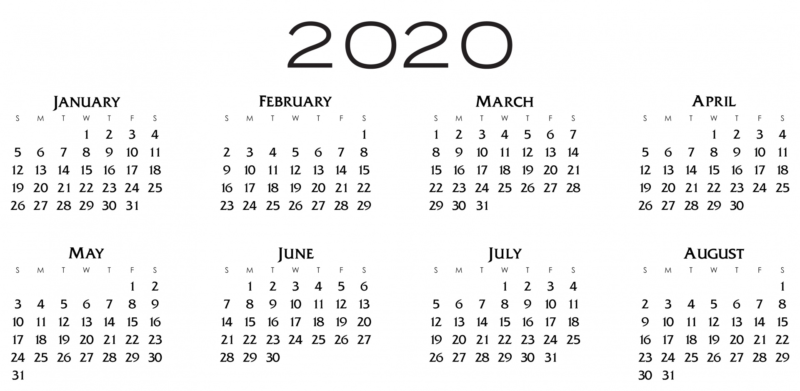
Notes:
What he could do is try attending one class, then attending

Slide 13
Notes:
… the other class, alternating which one he attends and which one he misses ...

Slide 14
?
?
?
Notes:
… but that only gets him until the end of February before he’s used up all his drops, so that doesn’t quite work.

Slide 15
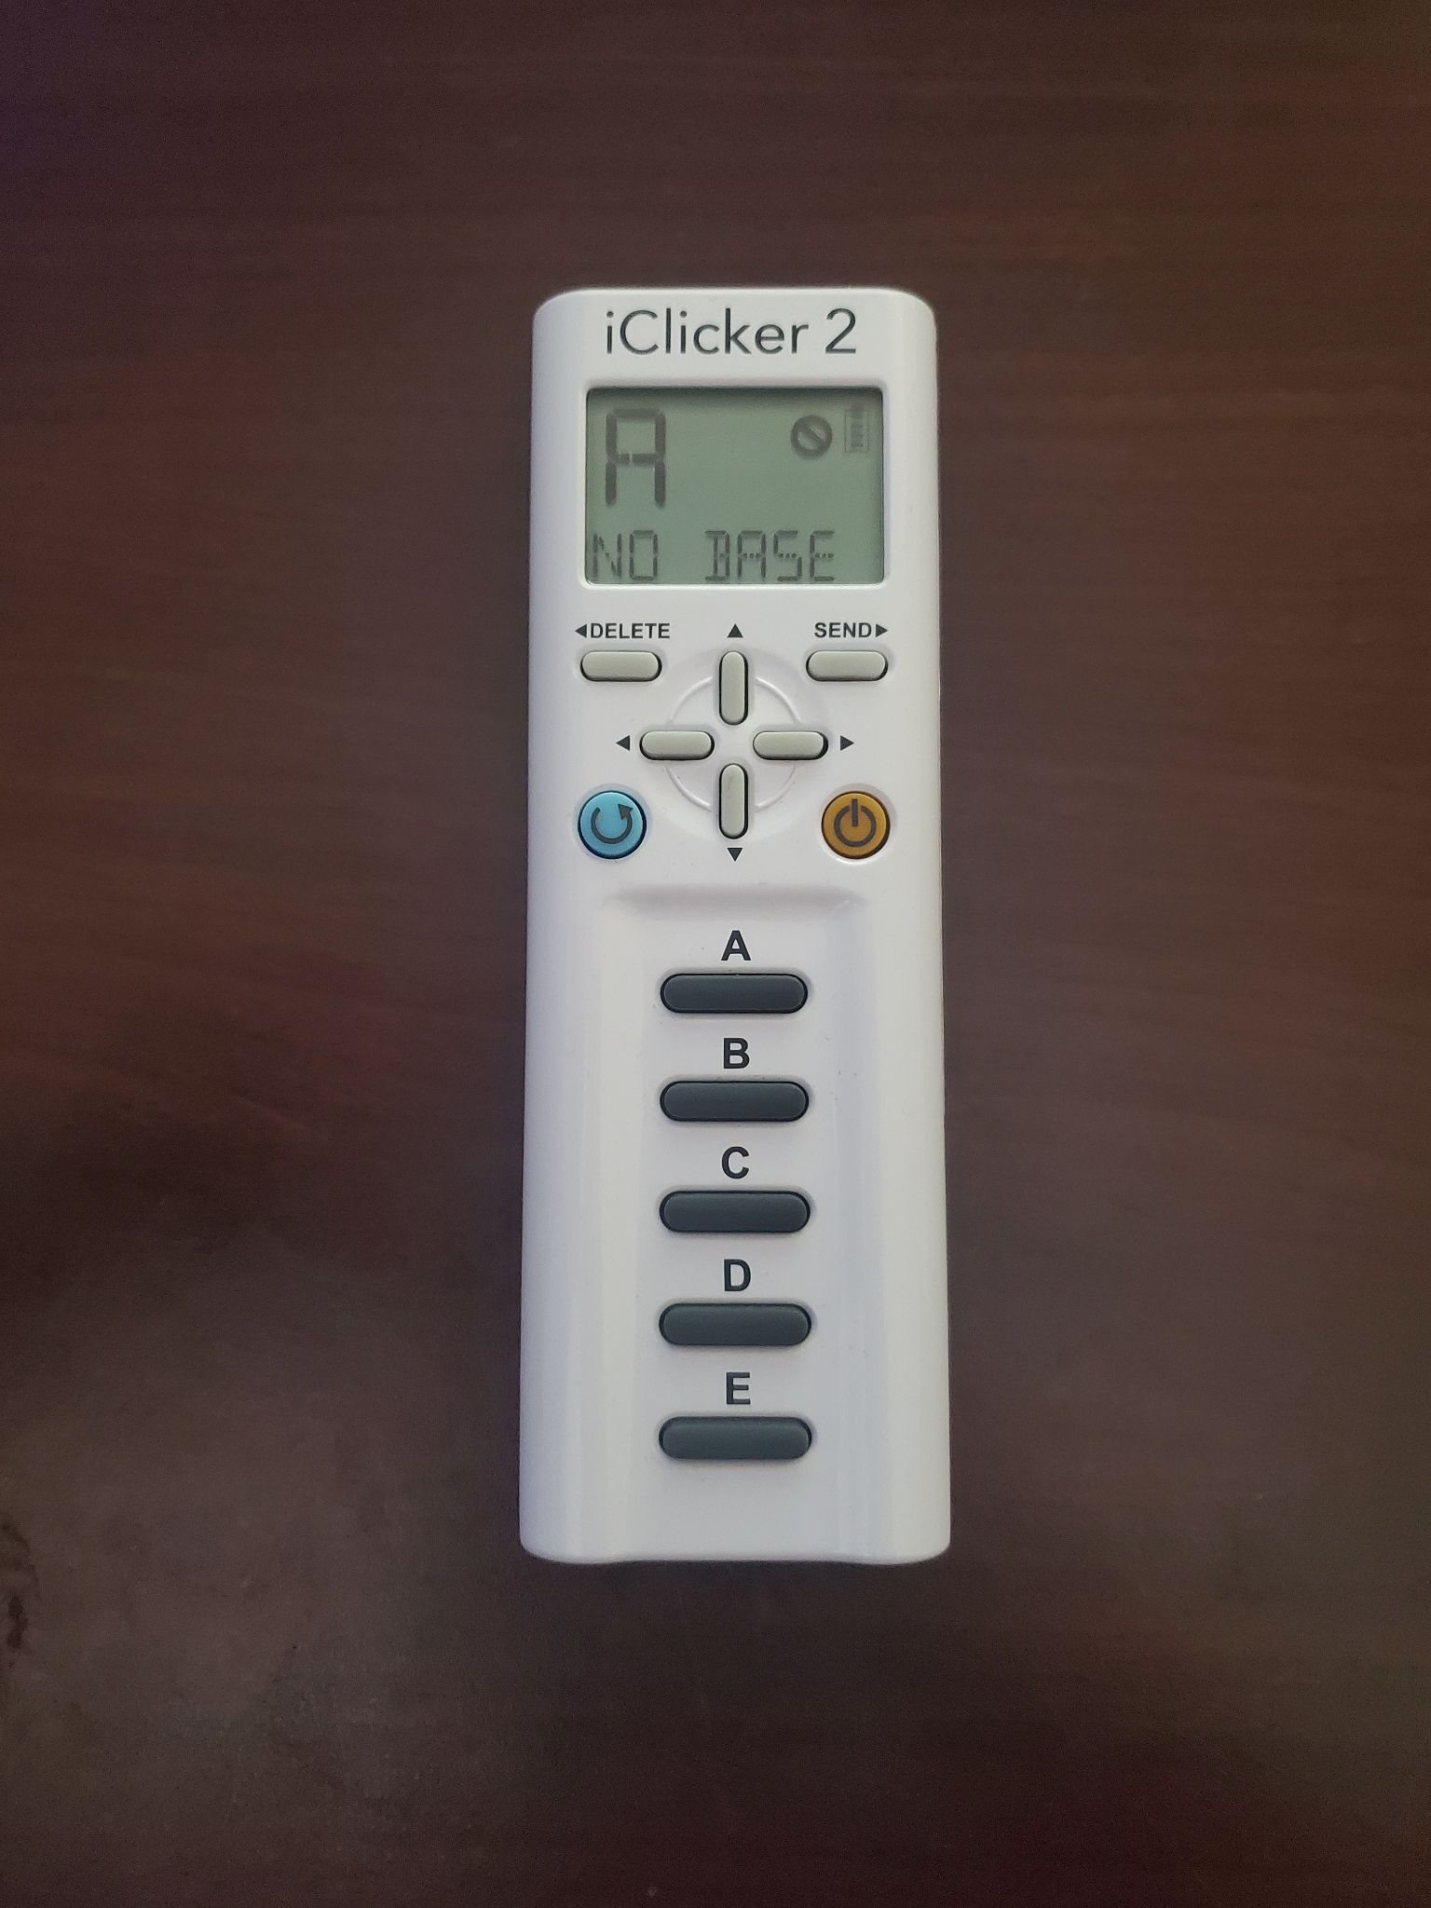
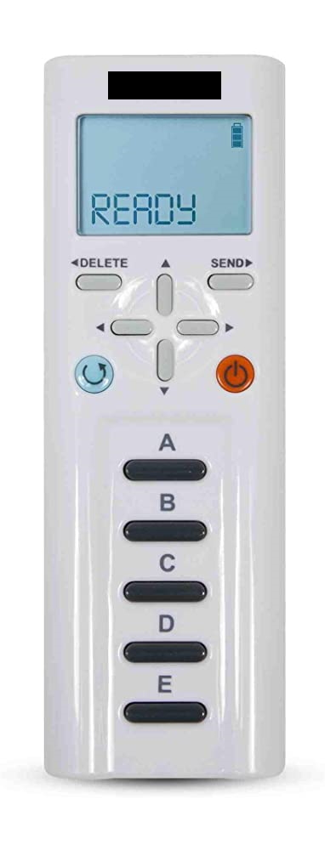
Notes:
Okay, but maybe he could try clicking in in one class, then...

Slide 16
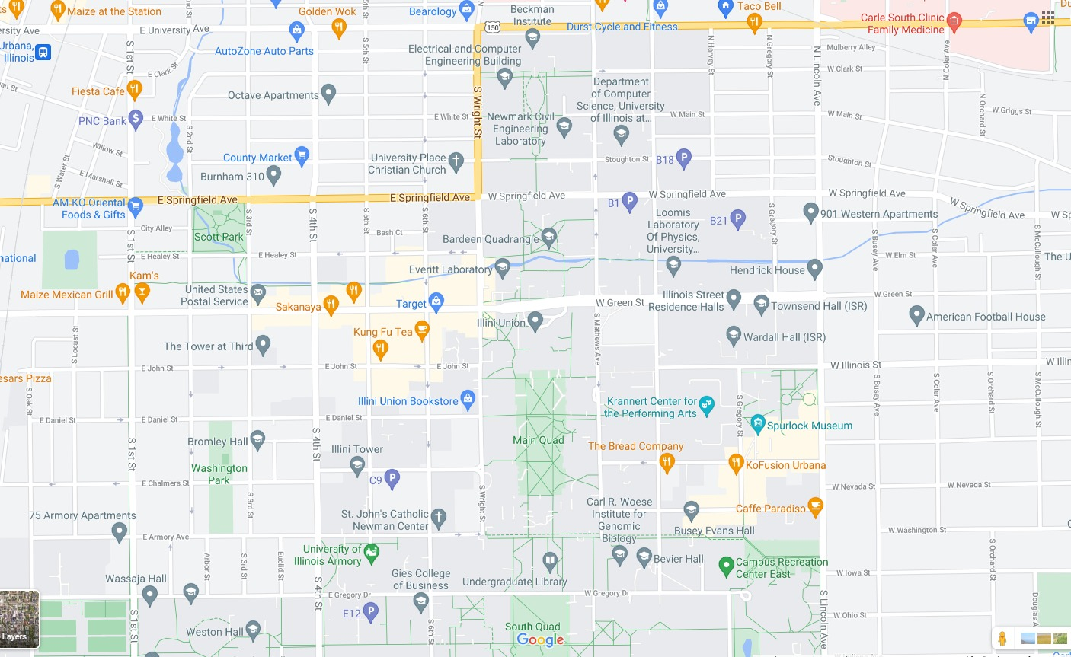
Notes:
… sprinting across campus to the next class to …

Slide 17
Notes:
… click in there, then …

Slide 18
Notes:
… sprinting back to the first class before the next lecture starts. But our mystery student

Slide 19
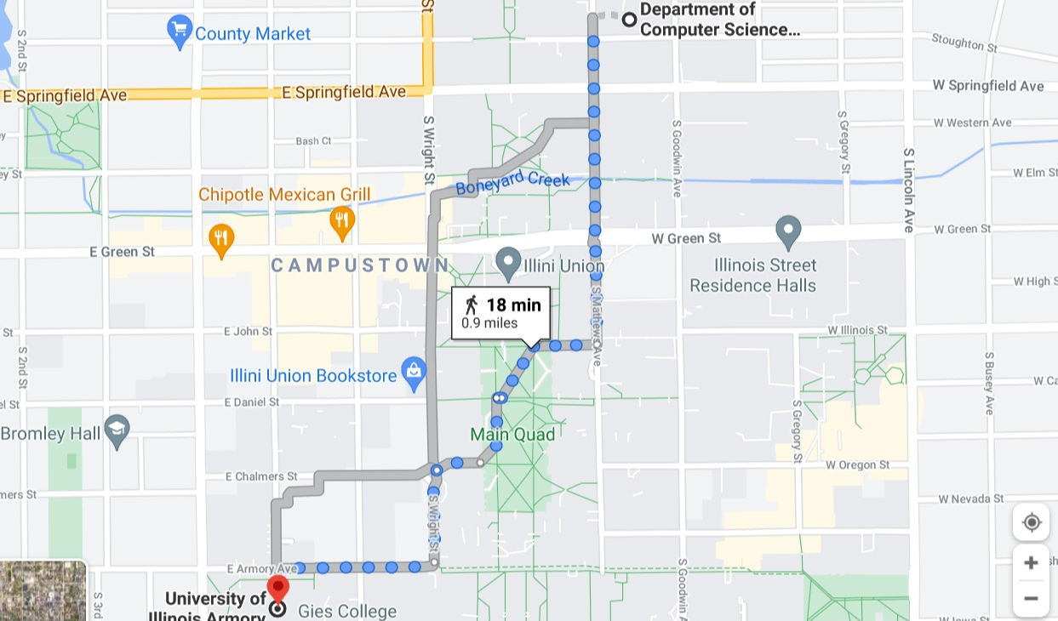
Notes:
Isn’t exactly Usain Bolt, so that one might not work either.

Slide 20
Notes:
What he really needed was a Time Turner. It’s this magical device from the Harry Potter series that the students used to take two classes at the same time — by time travelling. Now, without the luxury of magic, he would need the next best thing, which is, of course, hacking. Specifically, hacking the system which enforces his attendance. If he can get that system to mark him “present” in both classes, he would, in effect, be in two places at once.

Slide 21
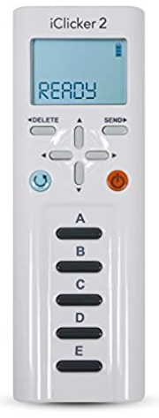

Notes:
Well the bad news is that this remote uses completely proprietary hardware and software to communicate with the base station. The good news is that hackers exist, so of course,

Slide 22
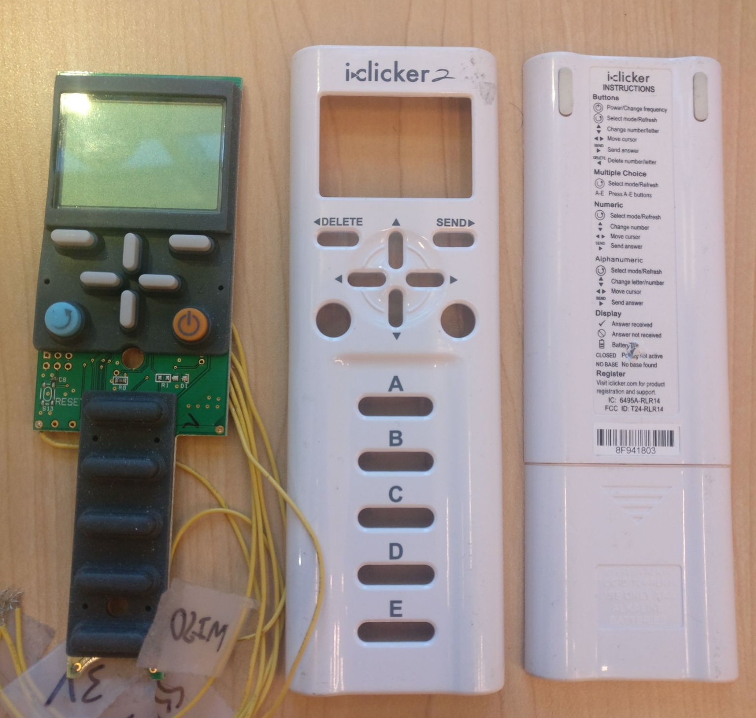
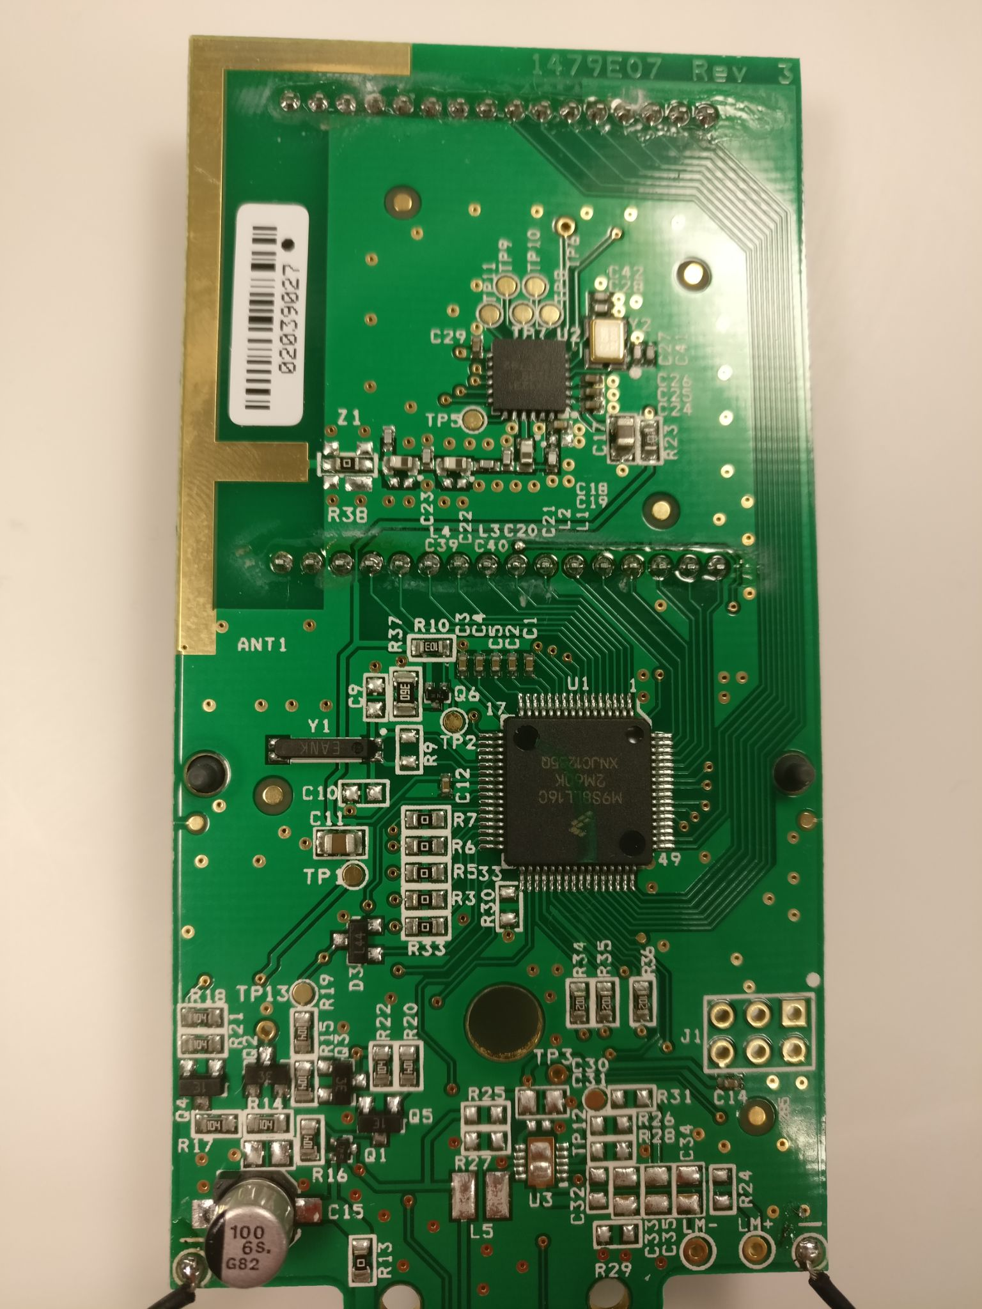
Notes:
It was quickly reverse engineered by some colleagues of mine at

Slide 23


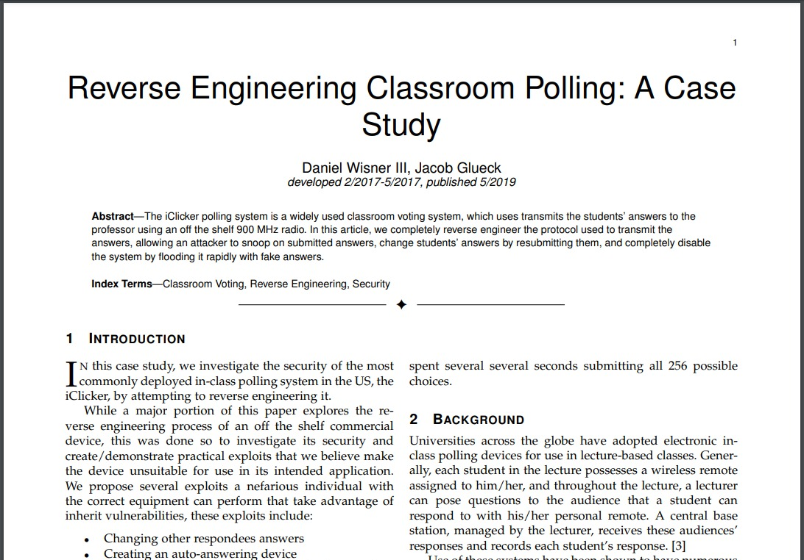




https://github.com/wizard97/iSkipper
https://github.com/charlescao460/iSkipper-Software
Aaron Wisner
Jacob Glueck
Charles Cao
Ammar Askar
Cole Smith
Prof. Bruce Land
(Advisor)
Notes:
Cornell. I’ve added some links here to their original paper, and it’s definitely worth the read. But for now, I’m first going to outline the techniques they used to approach reverse engineering this system, and then, I’ll explain what they found and how it could be exploited by our hypothetical student.

Slide 24
Notes:
This is actually a fairly simple device with only two significant ICs, the first being an

Slide 25
Notes:
8-bit microcontroller manufactured by NXP, and the second being a

Slide 26
Notes:
915 MHz ISM transceiver manufactured by Semtech. All one has to do to monitor the communications between these two components is

Slide 27
Notes:
tap into the data pins for the SPI bus here, which is

Slide 28
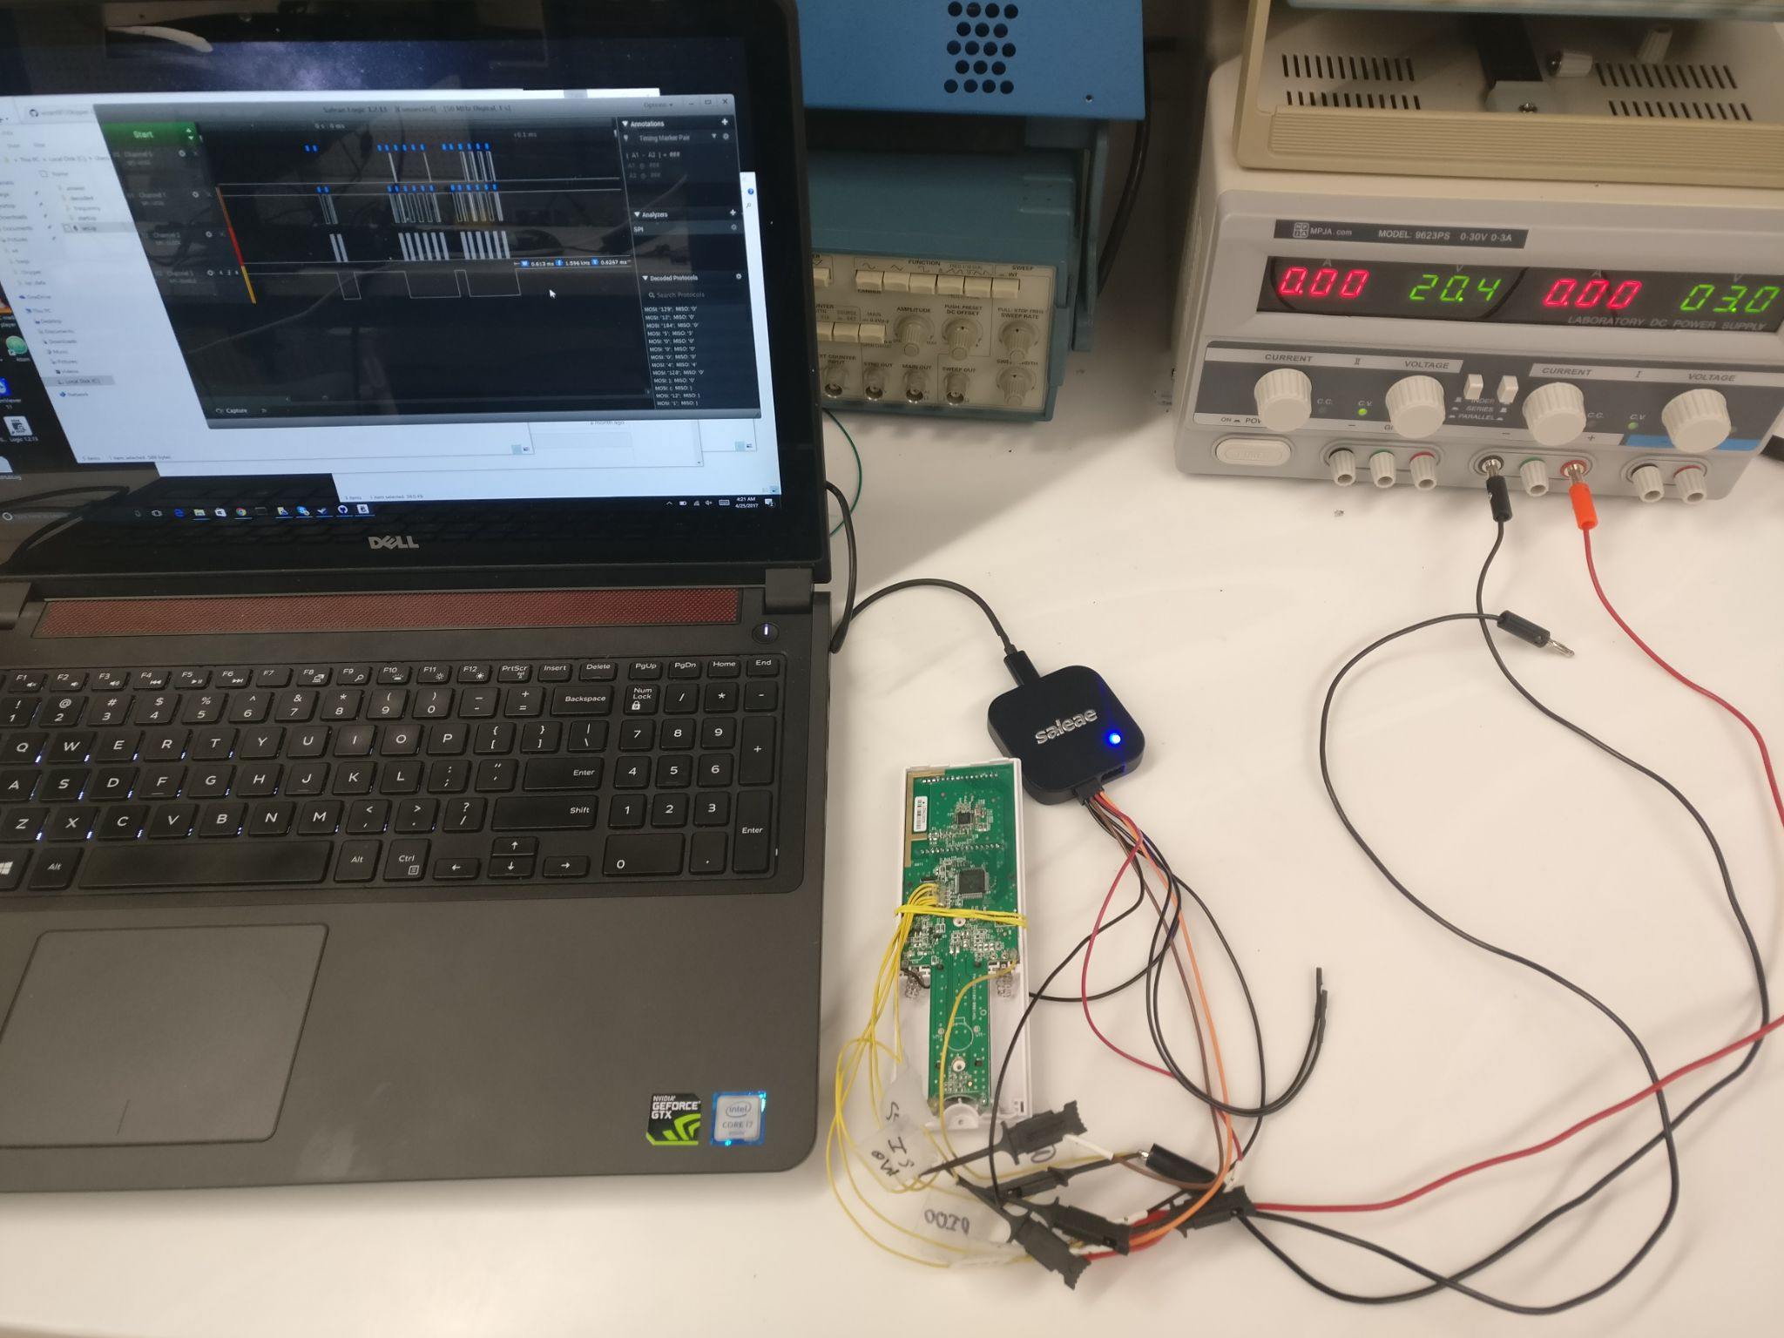
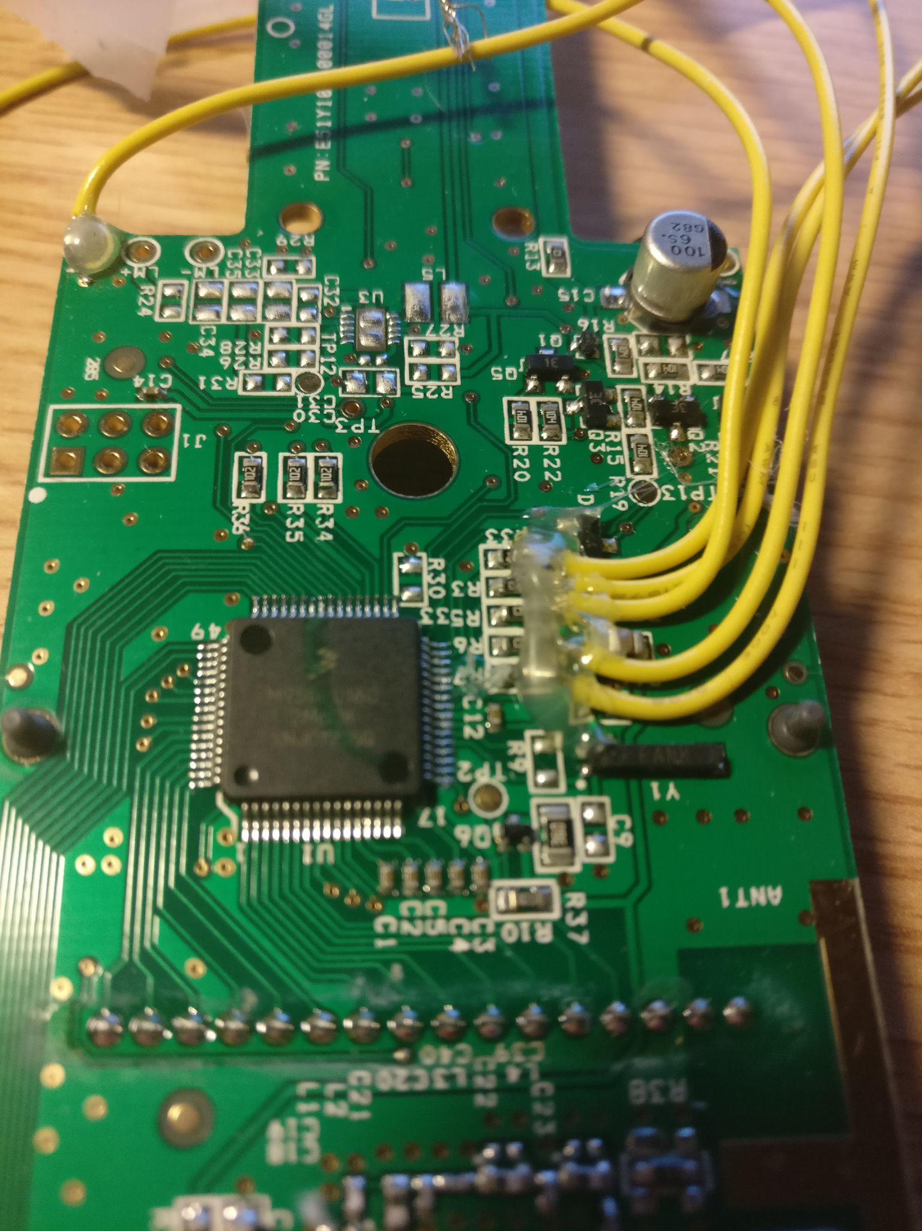
Notes:
exactly what my colleagues did to sniff the data in transit between the two ICs. It’s important to note that the manufacturer of this device prevented the firmware from being directly analyzed by burning the security program fuse. They didn’t, however, do this on an earlier version of the device, so that firmware is now available online.

Slide 29
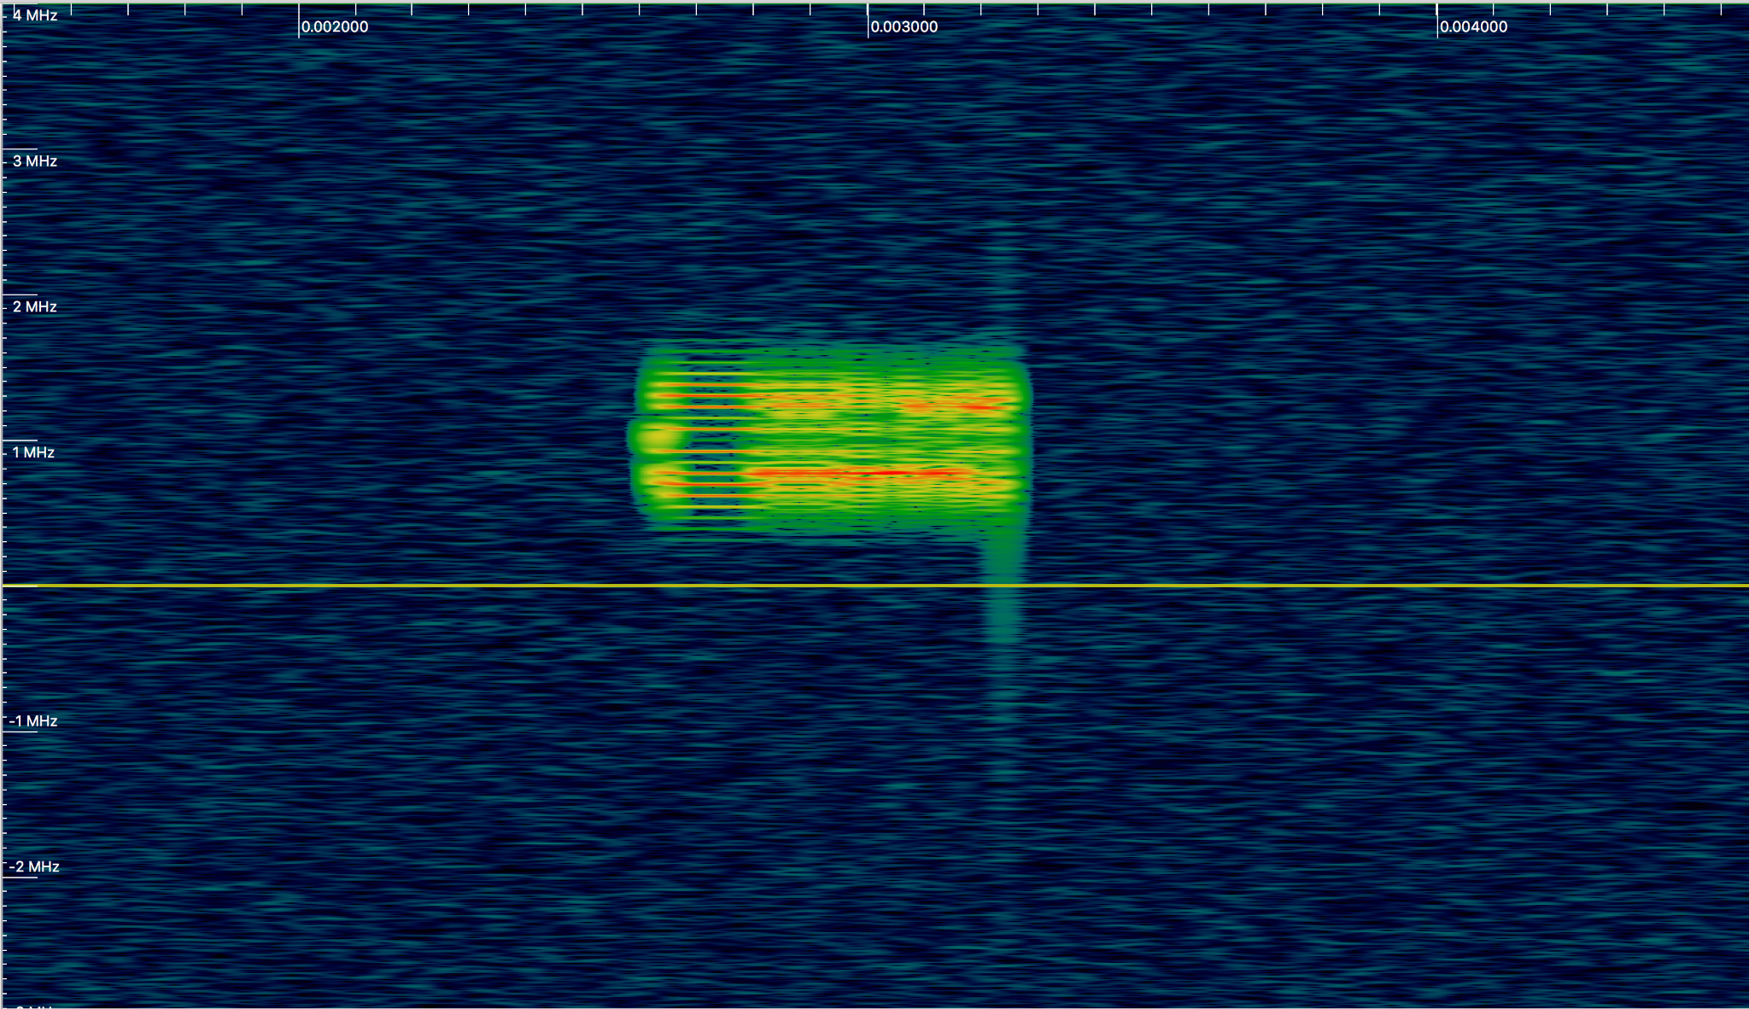
Notes:
Another thing my colleagues did was just packet sniff the RF signals to see what the device was emitting directly. A waterfall plot for the answer “A” is shown here.

Slide 30
Notes:
It seems like the device just broadcasts a single short packet for each response using 2-FSK modulation at a bitrate of 152 kb/s.

Slide 31
Notes:
The base station then sends back a single acknowledgement packet, although this is less important for our use case

Slide 32
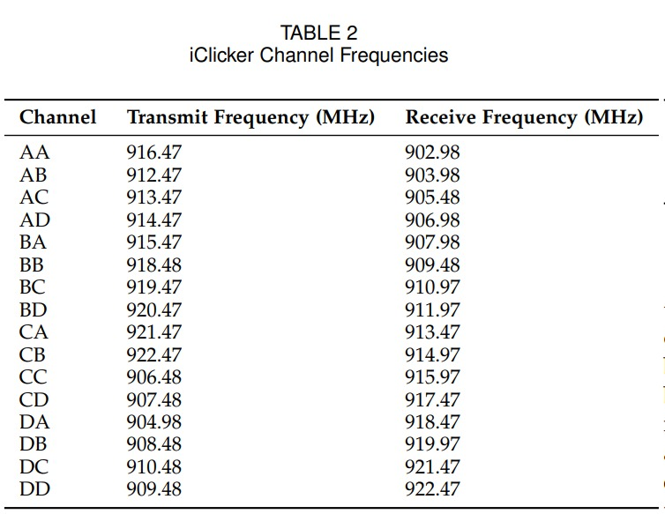
Notes:
The base station and the remote appear to negotiate a single fixed frequency for transmitting and one for receiving, depending on what channel they are set to use, although in practice, it’s almost always just AA.

Slide 33
Notes:
Now knowing the frequency and the encoding scheme, the researchers simply pressed each of the answers A through E

Slide 34
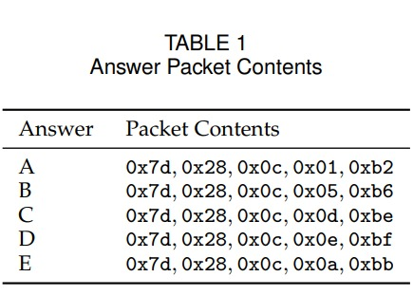
Notes:
and observed the contents of the resulting answer packet, which are shown here.

Slide 35
Notes:
Surprisingly, the packets the remote sends to the base station are just 5 bytes long which is just barely enough space to encode a device serial number and an answer with a checksum, so there can’t be much more than that going on

Slide 36
Notes:
Additionally, only the final two bytes of each packet actually change when the answer changes, so this must be the portion of the message which encodes the selected answer.

Slide 37
Notes:
The first three bytes of every packet are always the same which must mean that this is the portion of the message that encodes the device identifier. Let’s look at this part first.

Slide 38
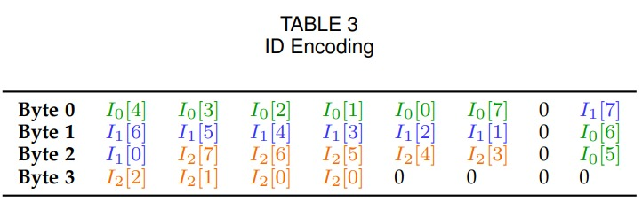
(Transposition Cipher)
Notes:
It turns out that what’s happening here is just a basic transposition cipher that just shuffles the bits of the device ID according to a predetermined and easily reversible system.

Slide 39
Device ID Checksum:
8F941803
0x8F ⊕ 0x94 ⊕ 0x18 = 0x03
(Transposition Cipher)
Notes:
It also turns out that the device IDs, which have 8 hexadecimal digits, contain a rudimentary built-in checksum, whereby the 4th byte is just the XOR of the first 3 bytes. Just by reversing the process in this table, we can now construct the first part of this answer packet for any valid device ID.

Slide 40
Notes:
Now, let’s look at the last two bytes of this message.

Slide 41
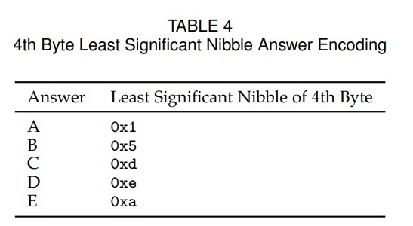
Notes:
The fourth byte of the message just encodes the answer choice according to a predetermined table.

Slide 42
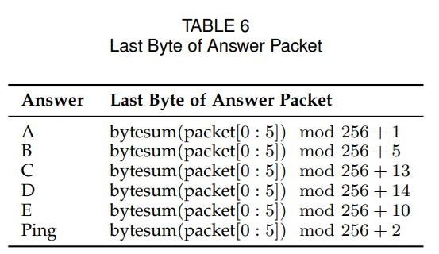
Notes:
The fifth and final byte is a checksum of the entire message according to this algorithm

Slide 43
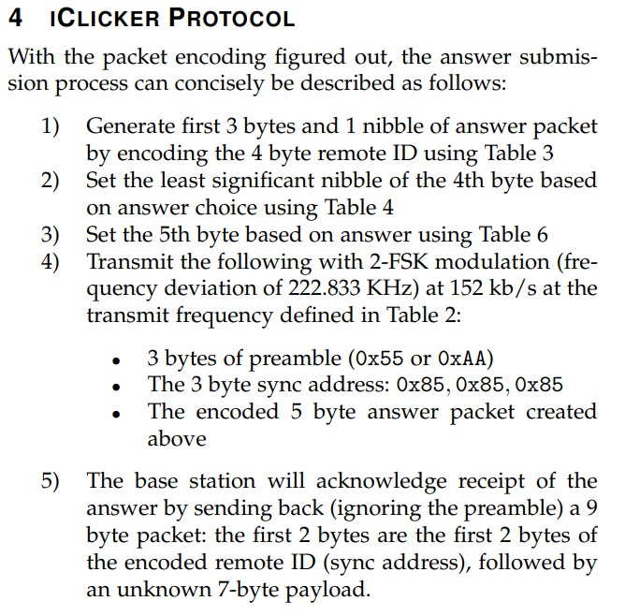
Notes:
We now have everything we need to reconstruct the entire protocol which is shown here. All that’s left to do is to build a device that can emulate the legitimate remote, and it turns out that

Slide 44
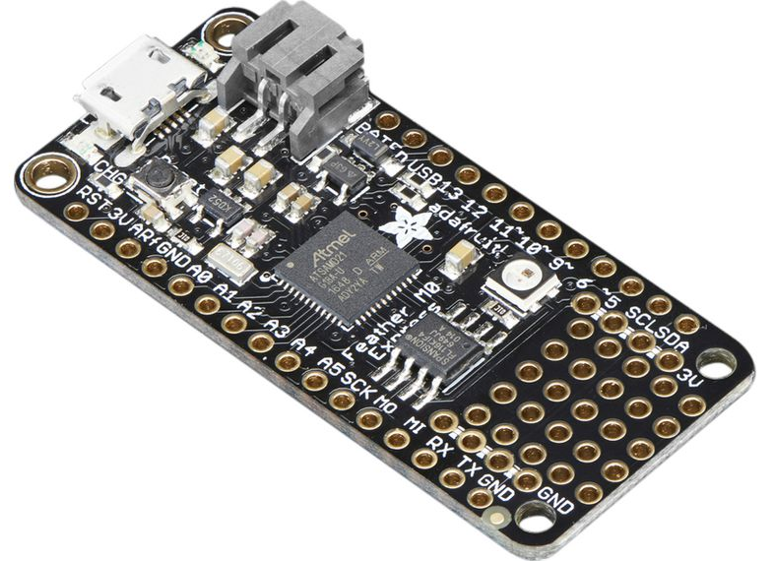
Notes:
this $25 Adafruit Feather M0 board has all of the hardware necessary to accomplish this.

Slide 45
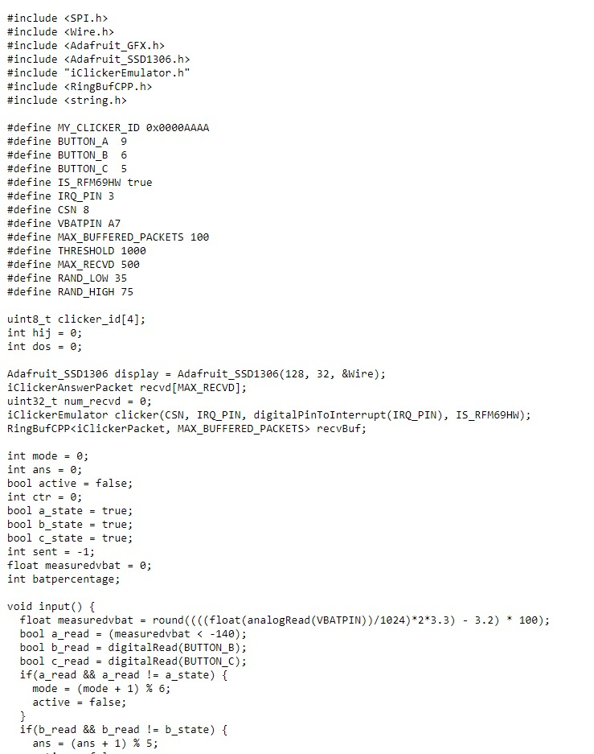
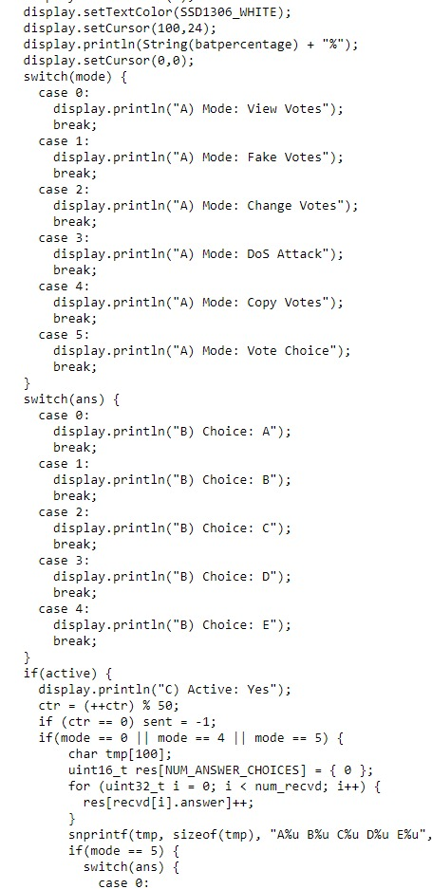
https://github.com/VCNinc/Time-Turner
Notes:
The firmware that I wrote to emulate the polling system is linked here along with a tutorial for how to set it up. The entire firmware compiles down to less than 10 KB and can comfortably reside in the Arduino’s built-in flash storage.

Slide 46
https://github.com/VCNinc/Time-Turner
Notes:
But enough talking about it - let’s see it in action.

Slide 47
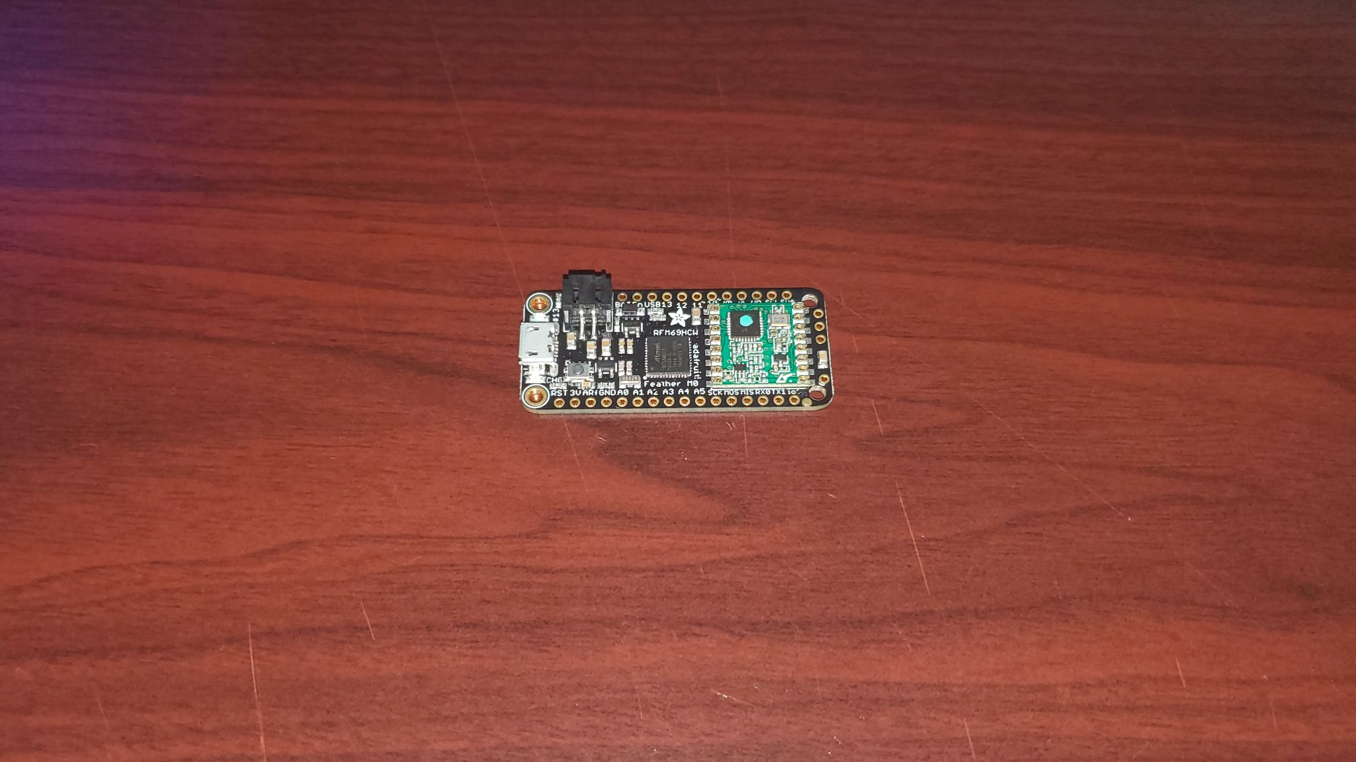
DEMO 2
Notes:
Alright, now for a brief demo. On my left is the legitimate polling system, and as always, if I select an answer on my remote, it will be broadcast and received by the base station. On my right is an Arduino running the custom firmware and initialized to a random serial number. It’s connected to my laptop right now with a USB so I can manually send it commands. And if I instruct it to broadcast an answer as if it were a remote, right now it will look to the base station as though another student is submitting an answer using their remote. Now let’s try this again, but this time, I’m going to set the Arduino to the same serial number as my remote. Now if I click in with my remote as normal, and then instruct the arduino to broadcast an answer, it will appear to the base station as though the same student is simply changing their response. In effect, these two devices are acting as if they are the same remote.

Slide 48
Notes:
As it stands, though, this only addresses half our problem, because although our student would now be able to transmit answers as if he were using a real remote, he still wouldn’t know which answer choice was correct unless he were physically present - and, frankly, even then it’s questionable. Luckily, by reverse engineering this protocol, it becomes as easy to emulate a base station as it is a remote, simply by setting the packet radio on the M0 to receive mode rather than transmit. This would then allow him to see what other students are answering and simply choose the most popular response.

Slide 49
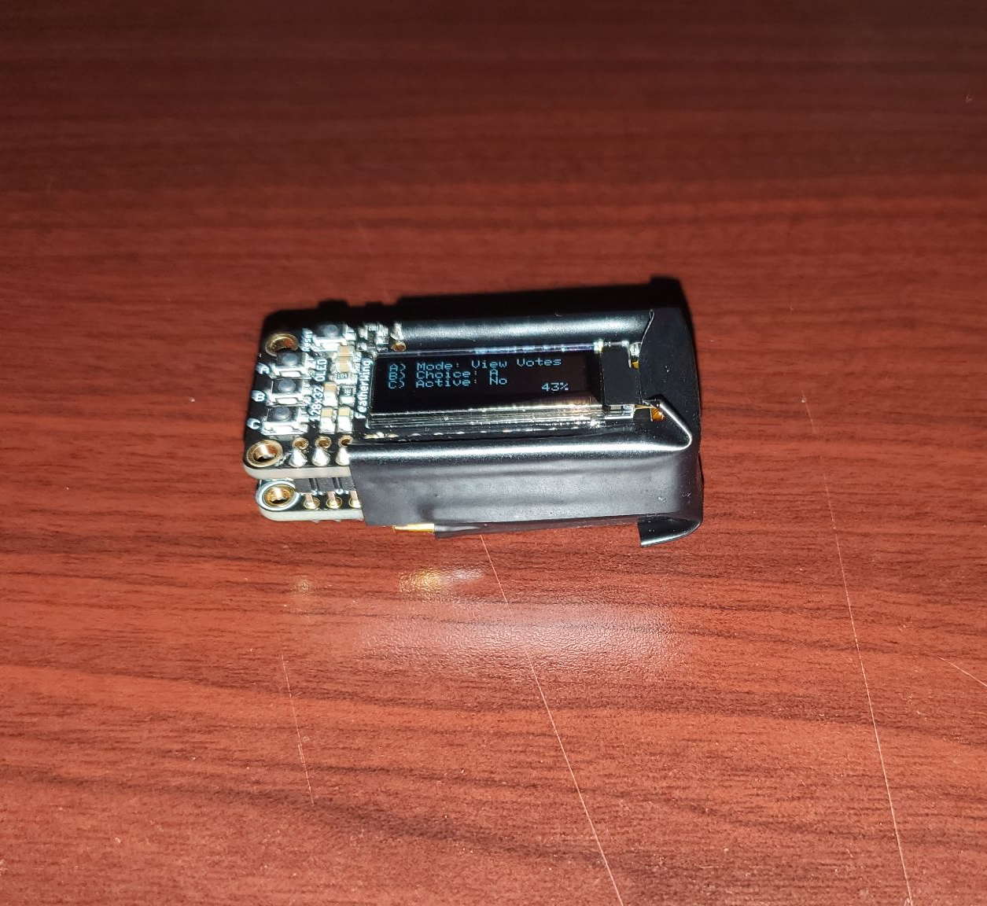
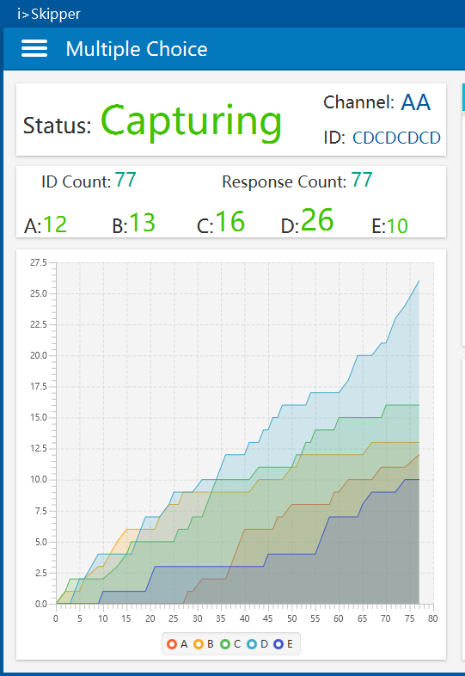
DEMO 3
Notes:
Okay, same demo as before, except this time my Arduino is setup to emulate a base station. So when a student submits an answer, it’s overheard not just by the legitimate base station, but also by the Arduino, which can then nicely display the student selections on my laptop.

Slide 50
“Time Turner” Protocol
Remain idle until the class is about to begin
Turn on and start emulating both a remote and a base station
Wait until device overhears a burst of radio traffic
Determine most popular student response using base station emulator
Broadcast most popular response from remote emulator
Repeat 2-5 until the expected end time of the class
Notes:
Obviously we don’t want to have to keep manually controlling this device. Luckily, if we combine the last two demonstrations, it’s not hard to imagine a fairly basic protocol for automating this process. We should start by instructing the device to remain idle until the class is about to begin. Then, it should turn on and start emulating both a remote and a base station. It should wait until device overhears a burst of radio traffic. It should then use the base station emulator to determine the most popular student response, at which point it should use the remote emulator to broadcast that same response. It should repeat those steps until the expected end time of the class, thereby answering every question and most of them correctly.

Slide 51
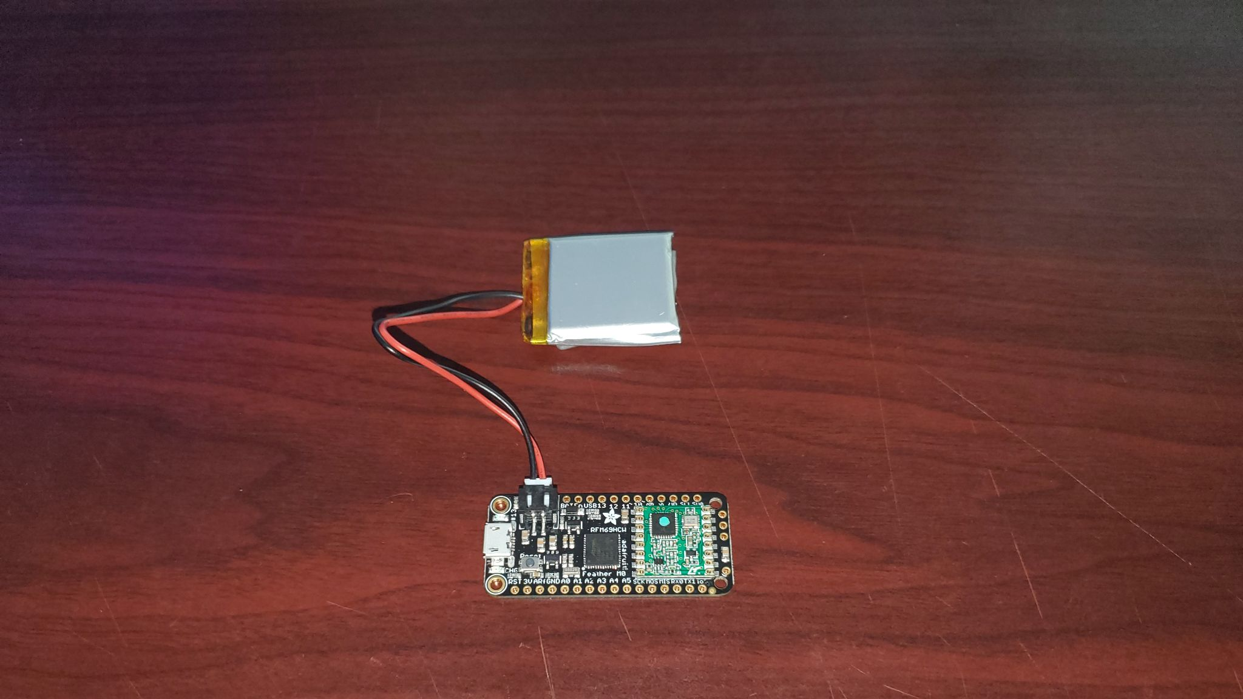
DEMO 4
Notes:
Now we’re getting somewhere, but this is not exactly a practical solution. It has to remain tethered to a PC and manually controlled. The first step towards a completely self-contained solution is to attach a standalone input device, which I’ve done here by crudely soldering on a 128x32px OLED screen with three input buttons. The nice thing about using an ultra-low-power platform like Arduino is that this device, even with a display attached, has a peak current draw of about 20mA as you can see here. So this tiny 500 mAh LiPoly battery should last well over 24 hours on a single charge. If I connect this up, we now have something resembling a practical self-contained device.

Slide 52
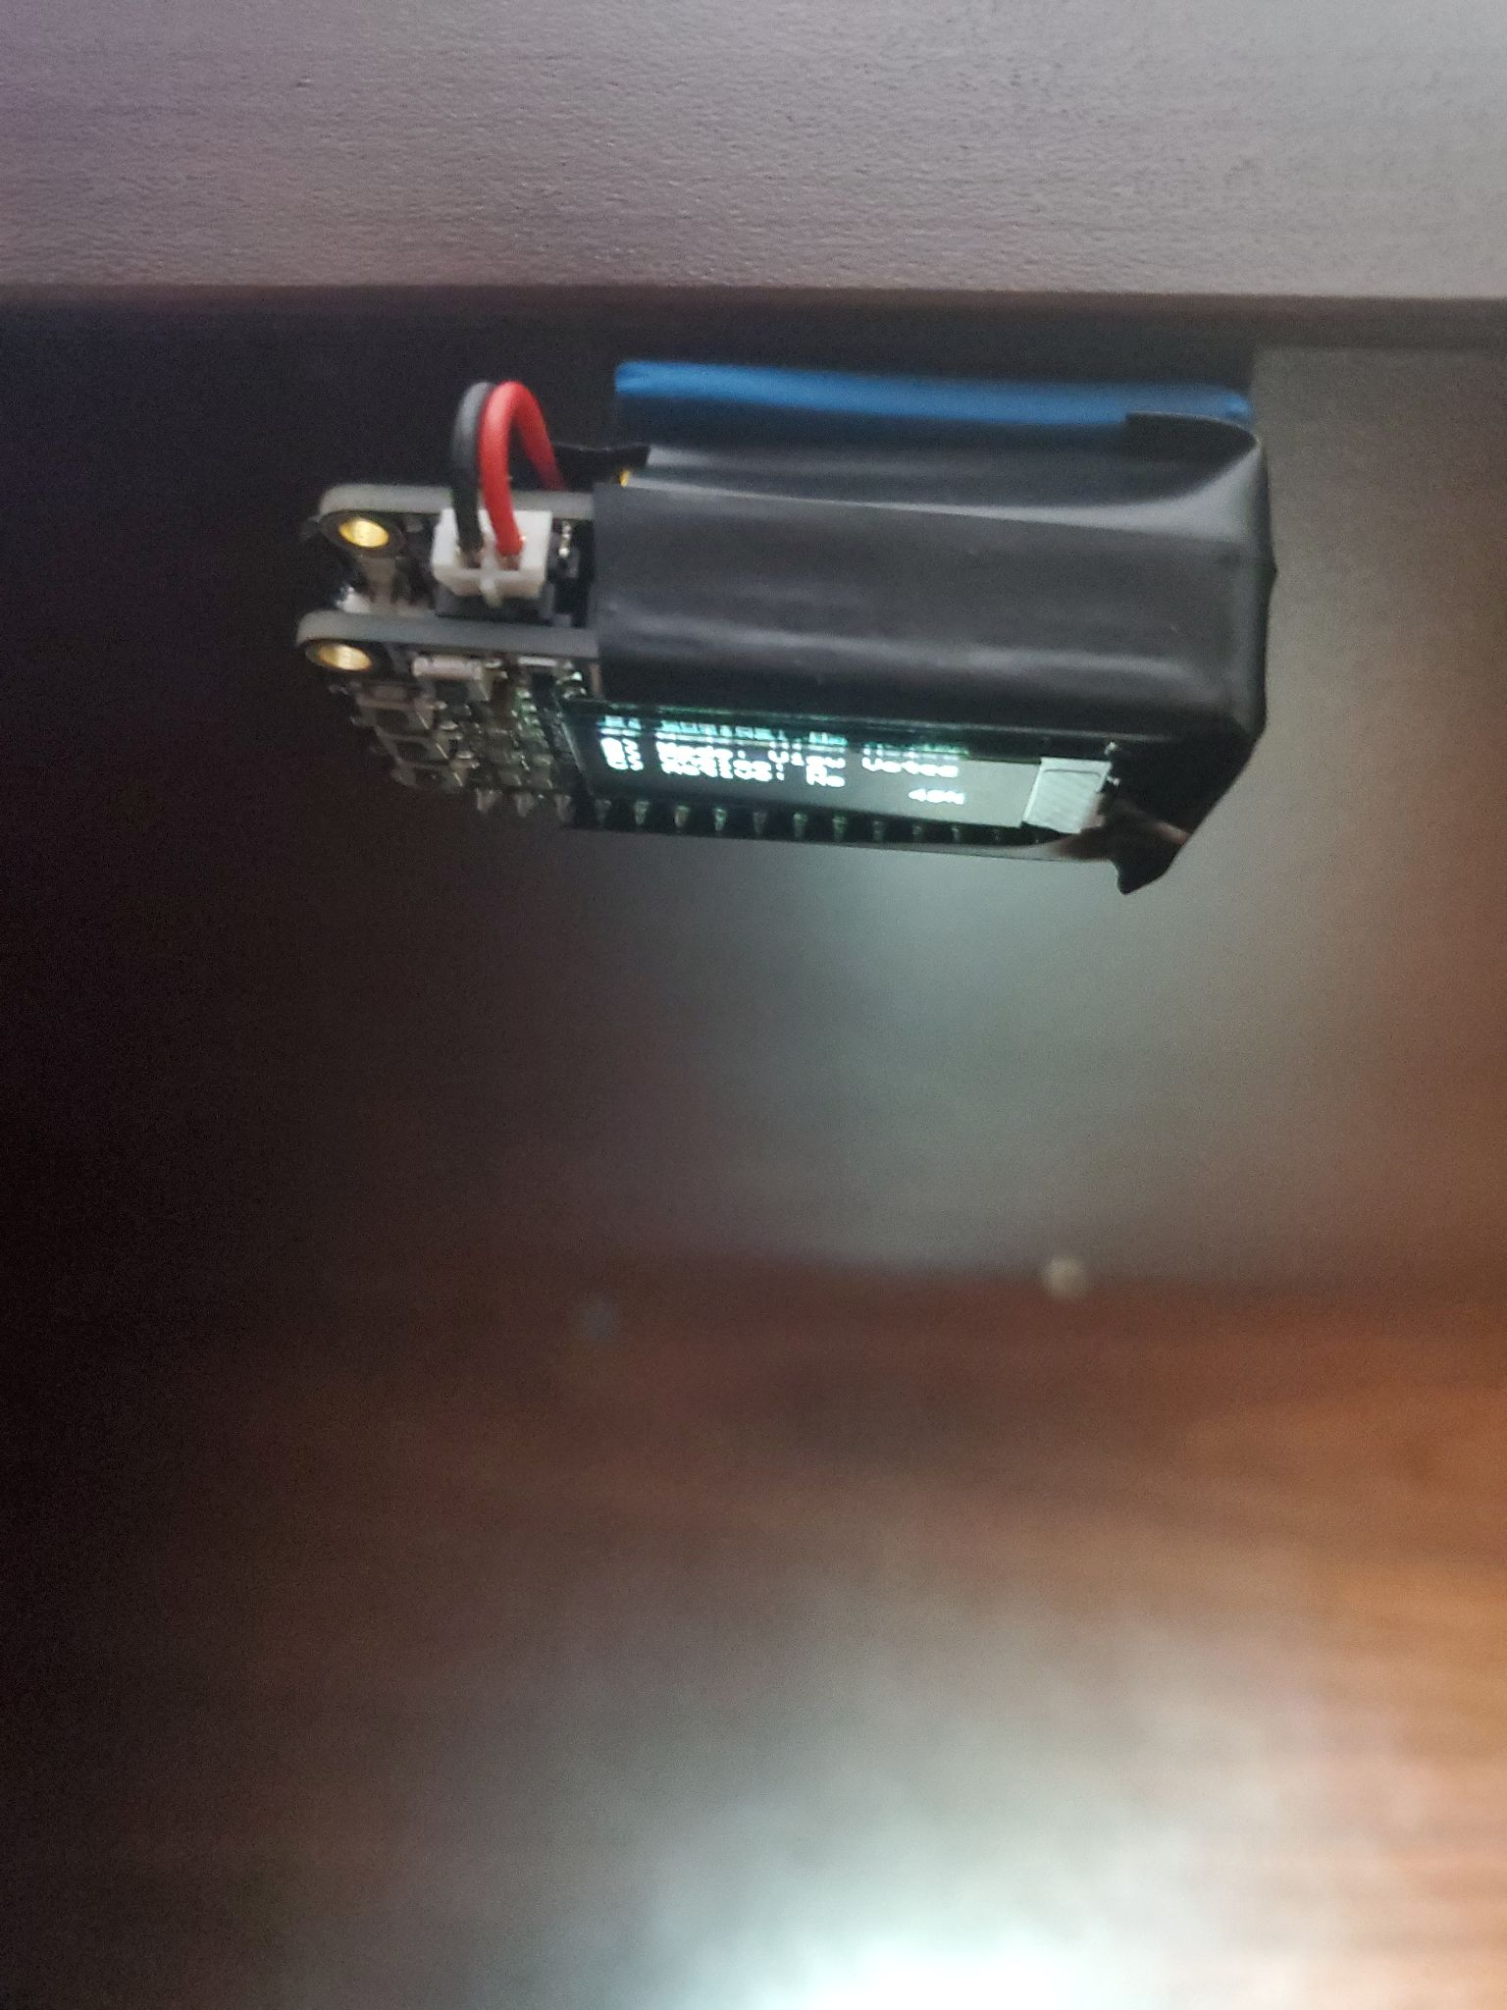
Notes:
Here’s the same device with just a little electrical tape to hold everything together. This finished device is what I call my “Time Turner.” It bears not much resemblance to the original but it can achieve many of the same results. Let me show you.

Slide 53
DEMO 5
Notes:
The most basic thing I can do with this time turner device is just submit a vote as if I were using a legitimate remote. This base station here still can’t tell the difference. Another thing I can do is just view the votes of my classmates. No matter which option I choose on this legitimate remote, it is automatically displayed on the time turner.
If I were more nefarious, what I could try to do is change the votes of my classmates. No matter what my classmate chooses, their vote will automatically be changed to ‘B’. Let’s try picking an answer. And no matter what I choose, it is automatically overwritten by the time turner device. Now, a vulnerability that allows me to change someone else’s vote on a so-called polling system is a major oversight.
But if I were more nefarious still, I could simply perform a denial of service attack. Submitting hundreds of votes per second will quickly overwhelm the host device, causing it to crash, and making it impossible for a legitimate device to submit their vote.
Let’s restart the poll one last time and demonstrate the most relevant attack for our use case. This time, the Time Turner will just copy whatever the most popular vote is. If the most popular vote changes to something else, the Time Turner will eventually change its vote, always making sure to stay within the majority.

Slide 54
DEMO 6
Notes:
The idea is that with just a little adhesive putty, the student can go in the previous night and covertly attach the device to some surface in the lecture hall, and he can be sure that the next morning, this device will attend class for him while he attends the other class the normal way.
Of course, if he can do this, then he can just as easily build two devices and attach them both to surfaces in the lecture hall, and he can just catch up on homework or sleep in. Now I’m not going to tell you if this student eventually just built these for all of this classes but...

Slide 55
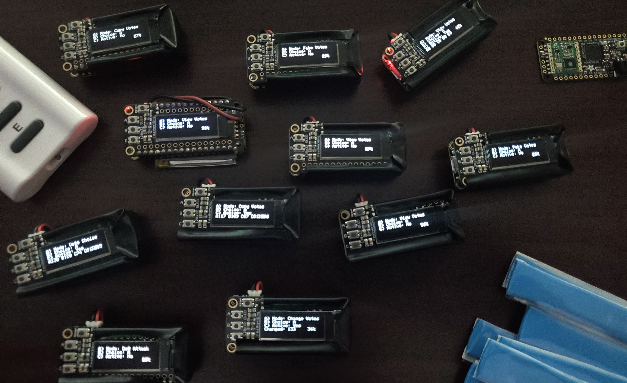
Notes:
… I’ll let you come to your own conclusion on that one.

Slide 56
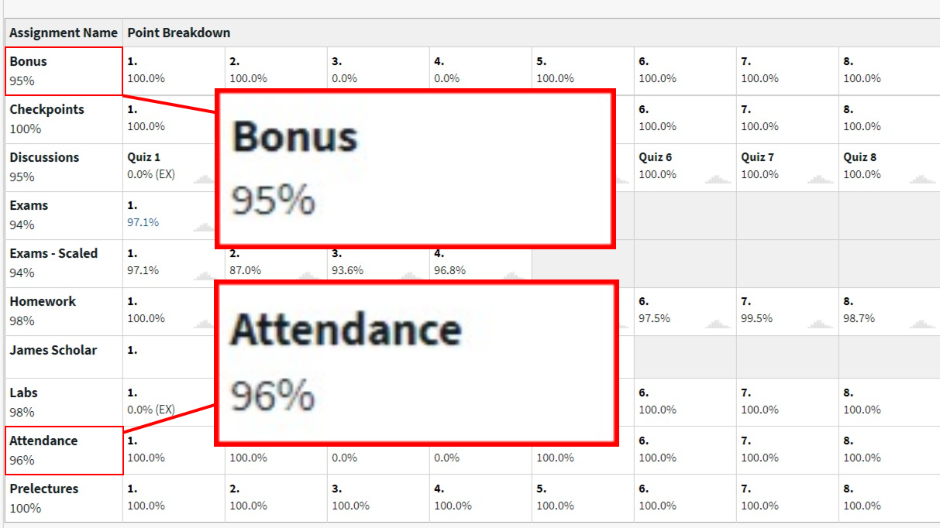
Notes:
What I will tell you is that these devices were pretty darn effective and that by mid-semester, the student had almost full points in both attendance and quiz correctness. So what does that tell us about this?

Slide 57
Authentication
Notes:
First of all, it’s a great lesson about Authentication. You may already know that

Slide 58
Authentication
An authentication mechanism can be:
Notes:
An Authentication mechanism should either be

Slide 59
Authentication
An authentication mechanism can be:
Something you know (eg. passwords)
Notes:
Something only you know, like a password

Slide 60
Authentication
An authentication mechanism can be:
Something you know (eg. passwords)
Something you have (eg. U2F keys)
Notes:
(show) Something you have like a universal second factor key

Slide 61
Authentication
An authentication mechanism can be:
Something you know (eg. passwords)
Something you have (eg. U2F keys)
Something you are (eg. biometrics)
Notes:
(show) or, Something you are, like your biometric data - these factors are all in theory, unique to you

Slide 62
Authentication
An authentication mechanism can be:
Something you know (eg. passwords)
Something you have (eg. U2F keys)
Something you are (eg. biometrics)
Polling devices???
Notes:
but this is a polling device; it’s being used incorrectly to authenticate someone’s physical presence at a lecture, when in fact, there’s no real authentication happening at all. It’s just broadcasting an answer and an ID number in plaintext over a radio signal.

Slide 63
Notes:
Now, to their credit, they did try to hide this by using a proprietary protocol that shuffles the bits around - but I mean this is an obvious violation

Slide 64
Kerckhoffs's Principle
A system should be secure even if everything except the key is public knowledge.
Notes:
of Kerckhoff's principle, which states that a system should be secure even if everything except the key is public knowledge.

Slide 65
Kerckhoffs's Principle
A system should be secure even if everything except the key is public knowledge.
Notes:
when using security through obscurity it’s only a matter of time until someone completely reverse-engineers your system and what little security you had disappears

Slide 66
Kerckhoffs's Principle
A system should be secure even if everything except the key is public knowledge.
Notes:
So, now that the security flaws of this system have come to light let’s talk about the various shortcomings of its design and how they might be addressed:

Slide 67
CIA Properties
Notes:
I think the flaws of this system map cleanly onto the three so-called “CIA properties” which are.

Slide 68
CIA Properties
Confidentiality
Notes:
Confidentiality

Slide 69
CIA Properties
Confidentiality
Integrity
Notes:
Integrity

Slide 70
CIA Properties
Confidentiality
Integrity
Availability
Notes:
and Availability. I’ll recount what I see as the core issues with this system and then propose a simple way to fix each of them.

Slide 71
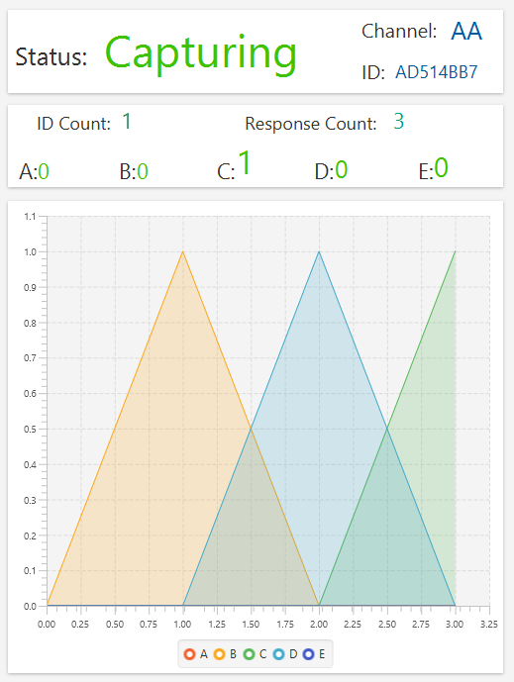
CIA Properties
Confidentiality
Integrity
Availability
Notes:
First, with regards to confidentiality - there’s none to speak of, AS I demonstrated when we were able to listen in to other students’ answers.

Slide 72
CIA Properties
Confidentiality
Integrity
Availability
Notes:
Next is integrity, and again, because I was able to build a device that could indistinguishably emulate my own or anyone else’s remote, and even change other people’s answers, the integrity of the answers received by a base station cannot be assured.

Slide 73
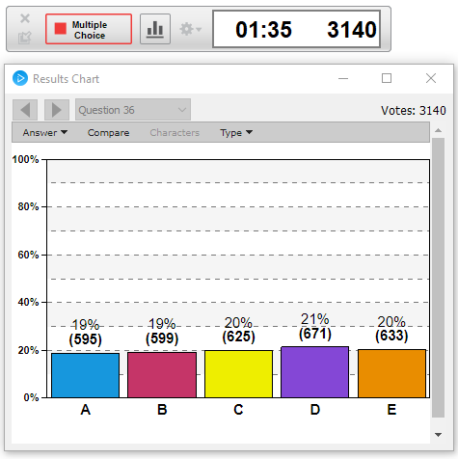
CIA Properties
Confidentiality
Integrity
Availability
Notes:
And finally, with respect to availability, I demonstrated a simple Denial of Service attack that would make it difficult for a legitimate remote to be heard. And now, as promised, some proposed solutions, staring with availability.

Slide 74
Availability
Notes:
This one is pretty straightforward: Every single remote in a classroom is transmitting and receiving on the exact same frequencies.

Slide 75
Availability
Notes:
For the default AA chanel, that’s about 916.5 and 903 MHz respectively. One would actually expect far more natural collisions and packet drops if each honest remote

Slide 76
Availability
Notes:
wasn’t broadcasting just 5 bytes at a time. But it does make the system particularly vulnerable to denial of service attacks as we saw.

Slide 77
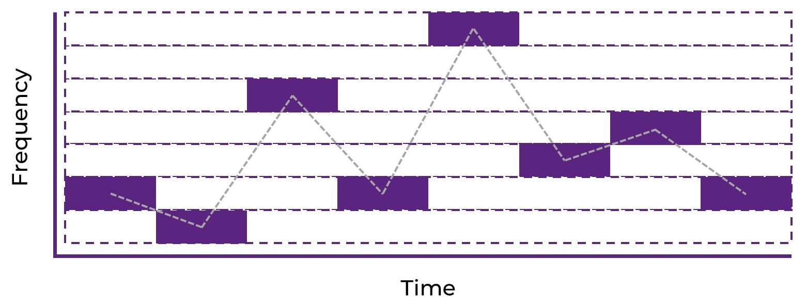
Availability
Frequency-hopping spread spectrum
Notes:
Perhaps a better idea would be to use FHSS, whereby the frequency used by a given remote rapidly changes in a way that is predictable to the base station but not to any passive observer.

Slide 78
Availability
Frequency-hopping spread spectrum
Notes:
Standardized protocols like Bluetooth already implement this by default and that’s for a good reason. It’s still not impossible to jam, but it becomes much harder and requires wide-spectrum radio frequency jamming

Slide 79
Availability
Frequency-hopping spread spectrum
Notes:
which is very expensive and very illegal. That’s not to say that any of these attacks are particularly legal if you’re not using your own system like I am here.

Slide 80
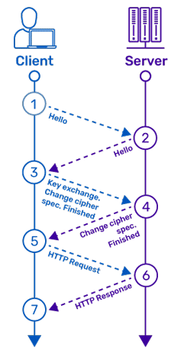
Confidentiality
Notes:
Next, confidentiality, which is also not too tricky. One way to address this would be for the base station and the remote to perform an authenticated key exchange when they first establish a connection,

Slide 81
Confidentiality
Notes:
, and then use the symmetric session key to encrypt all communications moving forward.

Slide 82
Confidentiality
Notes:
Something like mutual-auth TLS could be used to do this in a standardized way. In fact, the chip used by this device already has built in hardware support for AES, but it was intentionally disabled for whatever reason.

Slide 83
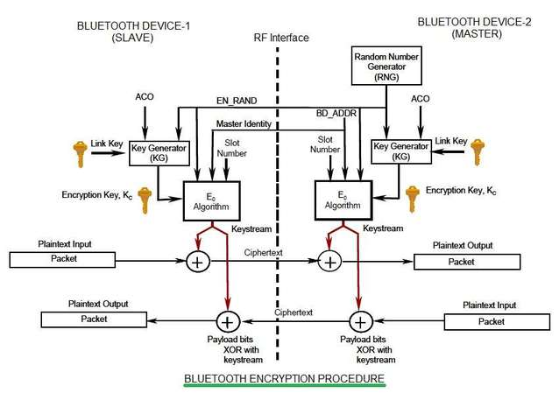
Confidentiality
Notes:
And again, standard protocols like Bluetooth would already do this by default although the mechanism there is a bit more intricate.

Slide 84
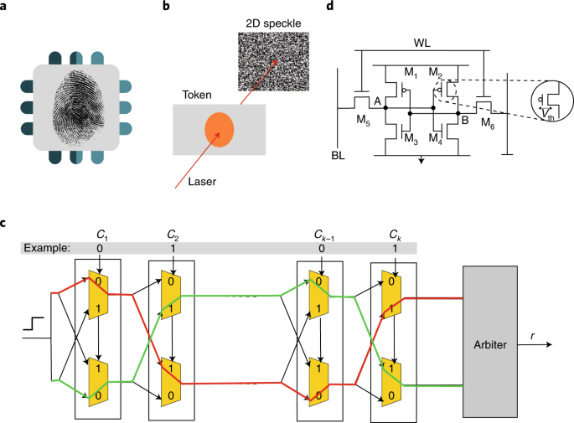
Integrity
Notes:
Finally, integrity - This is the trickiest problem to solve, but one idea might be to use a physically unclonable function (or PUF) - a LASER-based design is shown here, but silicon PUFs can be had for a few dollars,

Slide 85
Integrity
Notes:
and it would make it nearly impossible for me to build another device that replicates the exact behavior of my remote or the remote of any other student for that matter

Slide 86
Authentication
Notes:
This still doesn’t solve the broader problem of authenticating physical presence due to the possibility of relaying answers from a legitimate device to one or more remote locations.

Slide 87
Authentication
Notes:
To combat this, you would need to add a challenge-response mechanism with a tight time window,

Slide 88
Authentication
Notes:
just large enough for devices in close proximity to submit a response - a matter of microseconds - but not nearly what it would take to actually relay a message over the internet - which would be at least a few milliseconds.

Slide 89
Authentication
Notes:
A student, or at least their real remote, would therefore have to actually be in the room, in order to respond to the challenges sent by the base station fast enough for their attendance to count. Let’s summarize.

Slide 90
Security Summary
Notes:
It’s hard to overstate how vulnerable this system is, and it’s even more shocking that this exact model is currently used at over 1,100 universities and in nearly 100,000 classrooms.

Slide 91
Security Summary
Notes:
To summarize my security recommendations, if a new version of this system were released,

Slide 92
Security Summary
Use FHSS to avoid DoS attacks
Use encryption in transit
Notes:
they should consider using FHSS to avoid DoS attacks, and use encryption in transit to protect confidentiality.

Slide 93
Security Summary
Use FHSS to avoid DoS attacks
Use encryption in transit
Bluetooth (or BLE)
(Kerckhoffs's Principle)
Notes:
Bonus points if these first two problems are both solved by simply using an open standard which satisfies Kerckhoffs's Principle.

Slide 94
Security Summary
Use FHSS to avoid DoS attacks
Use encryption in transit
Use PUF
Use timed challenge-response
Bluetooth (or BLE)
(Kerckhoffs's Principle)
Notes:
Lastly, they could use a PUF with a timed challenge-response mechanism to produce what would then be an incredibly secure device, especially by comparison to its current form.

Slide 95
Security Summary
Use FHSS to avoid DoS attacks
Use encryption in transit
Use PUF
Use timed challenge-response
Bluetooth (or BLE)
(Kerckhoffs's Principle)
Notes:
By the way, these are also good general recommendations for hardware engineers designing similar devices for any of a variety of purposes - even, say, a garage door opener.

Slide 96
Security Summary
Use FHSS to avoid DoS attacks
Use encryption in transit
Use PUF
Use timed challenge-response
Bluetooth (or BLE)
(Kerckhoffs's Principle)
Notes:
Now it needs to be emphasized that PUFs and bluetooth chips are all already bulk-produced commodity hardware that cost a few dollars at the most; After all, this is

Slide 97
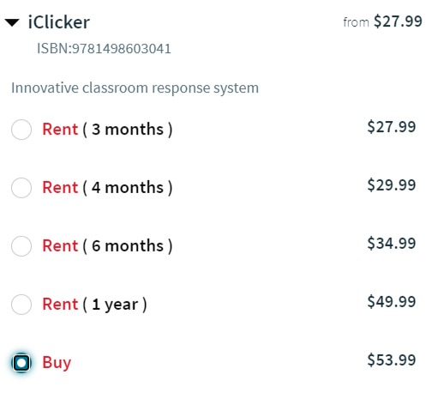
Notes:
a $54 device - so it’s hard to argue that there is a major cost barrier here. By the way, this one is about $30 if you already have a soldering iron. As for our canonical student, well as I mentioned this was all taking place in the Spring of 2020, and around the same time, another major world event was starting to unfold...

Slide 98
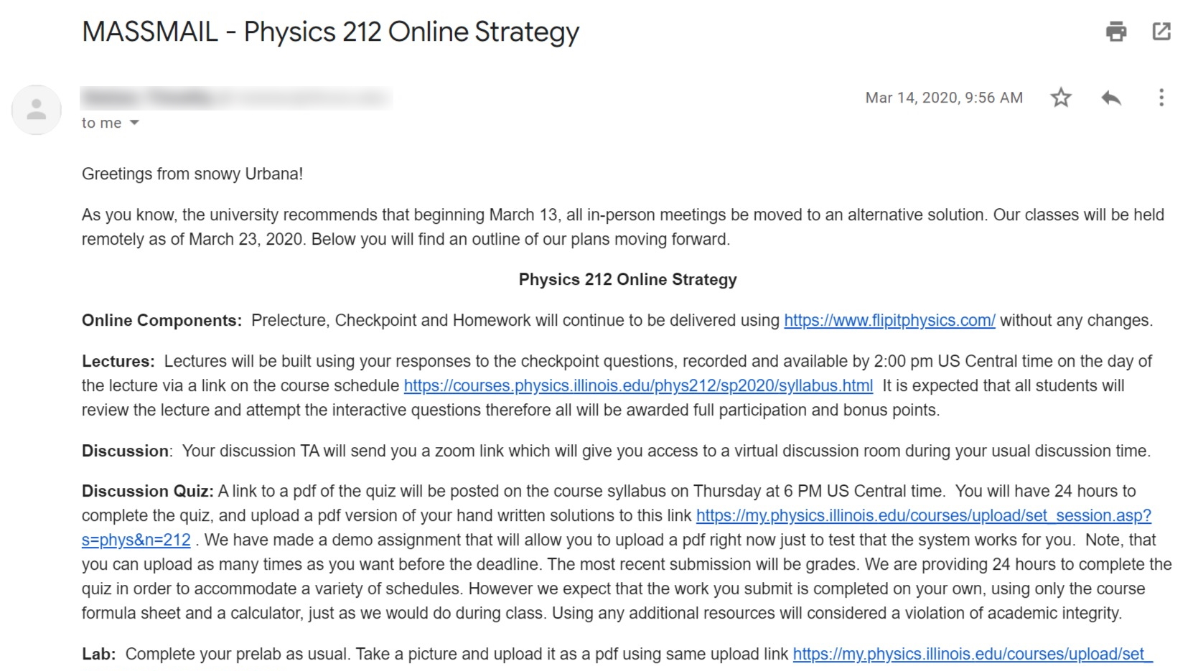
Notes:
So, of course, midway through the semester, he ends up receiving this email which, among other things...

Slide 99
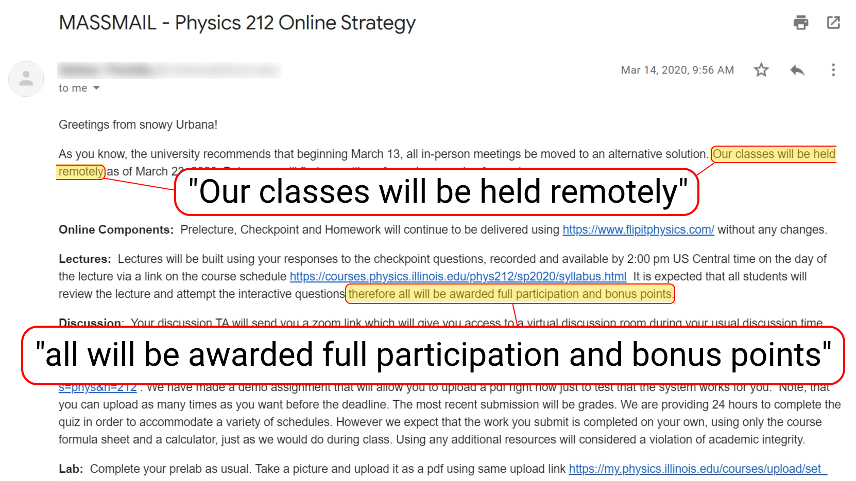
Notes:
… tells him that all of his classes have been moved online and that all students will receive full participation points. So while this didn’t end up being particularly helpful, hopefully it at least made for an interesting DEFCON talk. As for these days, if a student wanted to attend two classes at once today...

Slide 100
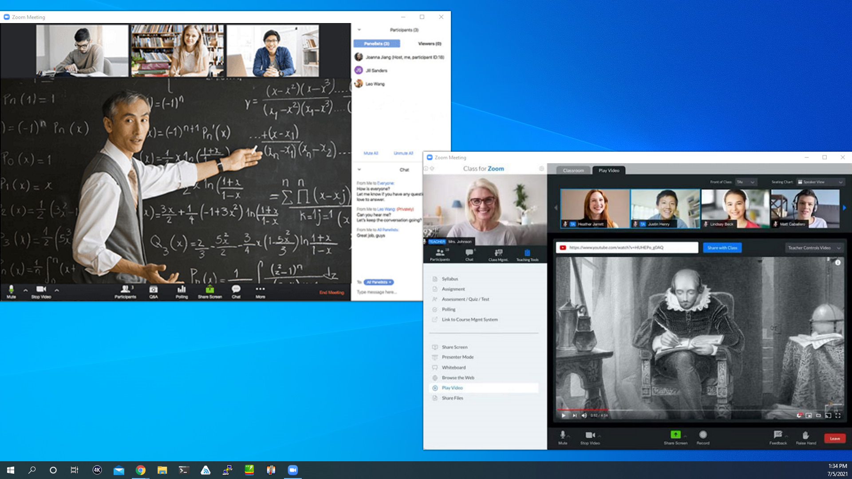
Notes:
… THIS is how they would do it. Thank you!

